Slide 1
Lab API Mgmt
NGINX API Mgmt and BIG-ip protection
Matthieu DIERICK
Solution Architect
September 13, 2022

Slide 2

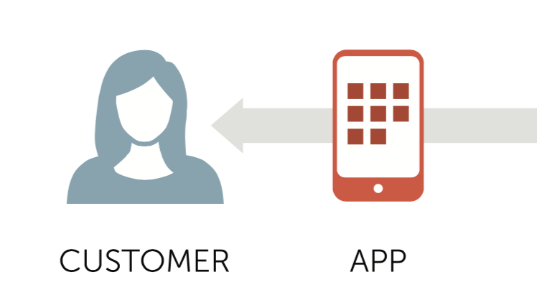
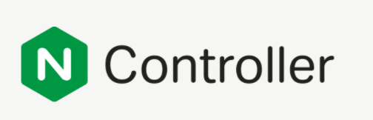
NMS - API Connectivity Manager
D
D
D
API GW
E
E
E
Notes:
AWS scaling group
Azure scaling group (Tewfik)
Query KubeDNS in K8S
K8S Ingress Container
Controler to push Declarative or API call to AWAF for API update/changes

Slide 3


D
D
D
E
E
E
Notes:
AWS scaling group
Azure scaling group (Tewfik)
Query KubeDNS in K8S
K8S Ingress Container
Controler to push Declarative or API call to AWAF for API update/changes

Slide 4
Architecture network diagram
Nginx-1 – API GW
Port 31100
Adjectives
API
10.1.20.6:80
Port 31101
Animals
Port 8080
Port 31102
Colors
Port 31103
Locations
Port 31200
Port 8080
Generator
Port 30274
Port 8080
WebApp
FrontEnd

Slide 5

Architecture network diagram
Nginx-1 – API GW
NAP
Port 31100
Adjectives
API
10.1.20.10:80
10.1.20.6:80
Port 31101
Animals
Port 8080
Port 31102
Colors
Port 31103
Locations
Port 31200
Port 8080
Generator
Port 30274
Port 8080
WebApp
FrontEnd

Slide 6
API mgmt. with Nginx Controller and NAP
D
D
D
API GW
E
E
Nginx App Protect
E
Notes:
AWS scaling group
Azure scaling group (Tewfik)
Query KubeDNS in K8S
K8S Ingress Container
Controler to push Declarative or API call to AWAF for API update/changes

Slide 7
Backup slides
Next steps roadmap

Slide 8
API mgmt. with controller Hybrid sec + scaling
AuthZ
LB
Rate Limiting
Data manipulation
Req routing
WAF for NGINX
D
D
D
SSO JWT Bearer
API GW
K8S Ingress
E
TLS termination
Bot protection
DDoS protection
AuthN – JWT validation
WAF for BIG-IP
E
E
Notes:
AWS scaling group
Azure scaling group (Tewfik)
Query KubeDNS in K8S
K8S Ingress Container
Controler to push Declarative or API call to AWAF for API update/changes

Slide 9
AuthN/Z workflow (extra lab)
AuthZ with only one JWT key file
(key from APM)
Admin can scale out NGINX+ easily
Bearer SSO
API GW
AuthN/Z with AzureAD or any other IDaaS
(Routing keys from AAD)
Notes:
AWS scaling group
Azure scaling group (Tewfik)
Query KubeDNS in K8S
K8S Ingress Container
Controler to push Declarative or API call to AWAF for API update/changes

